Slide 1

IPL Match and Delivery Data Analysis

Slide 2
Data Understanding
The dataset consists of the information about all Indian Premier League Cricket matches between 2008 and 2016. The dataset contains 2 files: deliveries.csv and matches.csv.
The dataset comprises of
matches.csv contains details related to the match such as location, contesting teams, umpires, results, etc.
deliveries.csv is the ball-by-ball data of all the IPL matches including data of the batting team, batsman, bowler, non-striker, runs scored, etc.
Agenda:
Perform exploratory data analysis using python and data visualization techniques to review team performance in last five overs and compare against match result (win/loss).

Slide 3
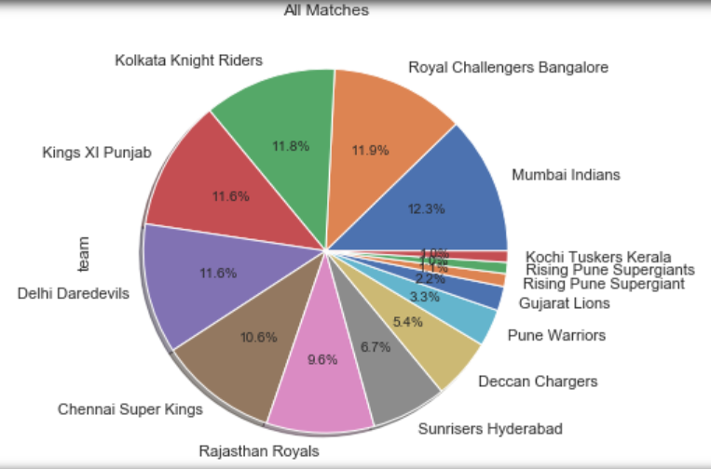
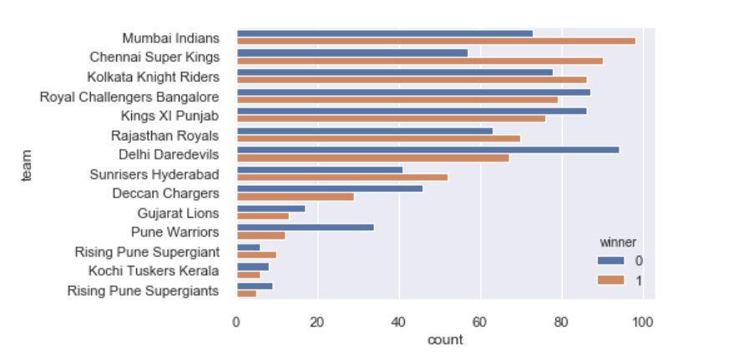
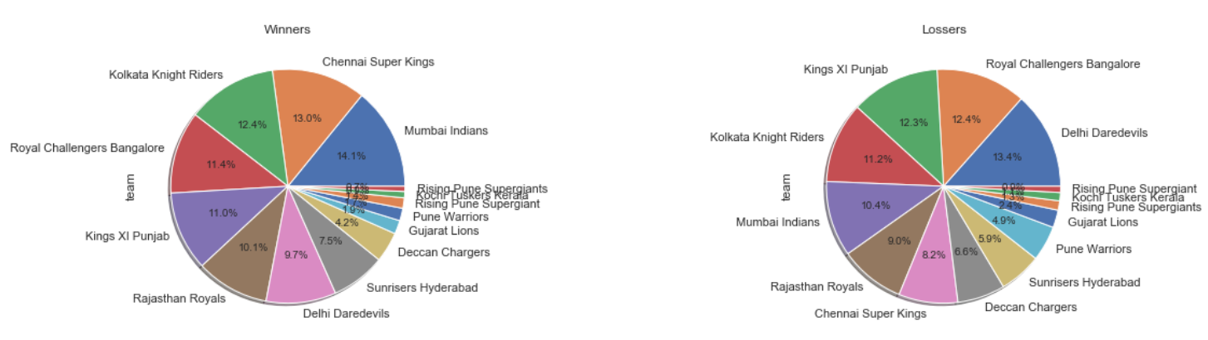
Matches Statistics
You can see that Mumbai Indians won most matches followed by Chennai Super Kings. Notice that Mumbai Indians won most 98, followed by Chennai Super Kings (90).
Above data confirm that Mumbai Indians won most matches, however Chennai Super Kings has highest winning % of 61.22

Slide 4
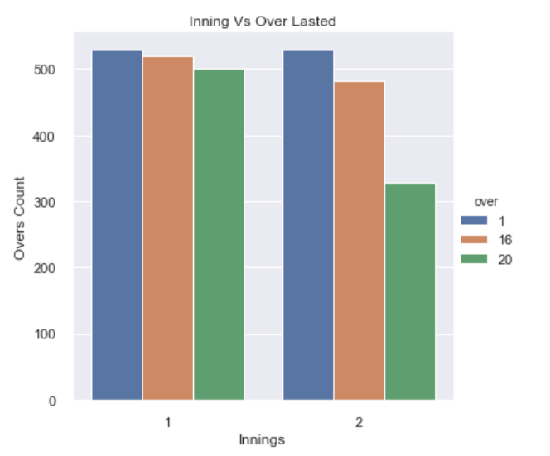
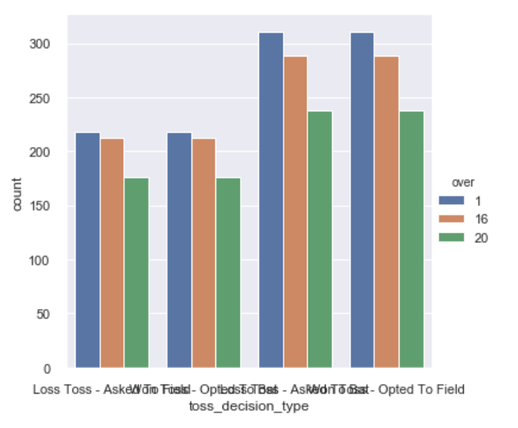
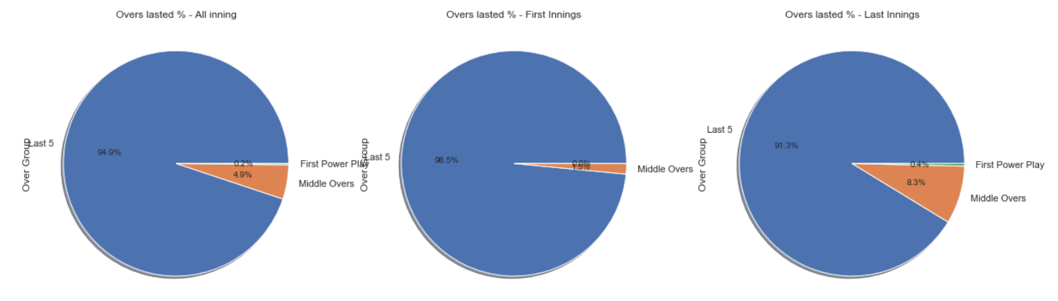
Inning Statistics
Notice: Above graph is showing innings 1st over count against 20th over count to analyze how many inning lasted till last over.
Conclusion In all 750 (325*2) innings, most of 1st innings lasted till last over. However, quite a few 2nd innings didn't last till last over. Good amount of matches went into last 5 overs (evident from 16th over plot)

Slide 5
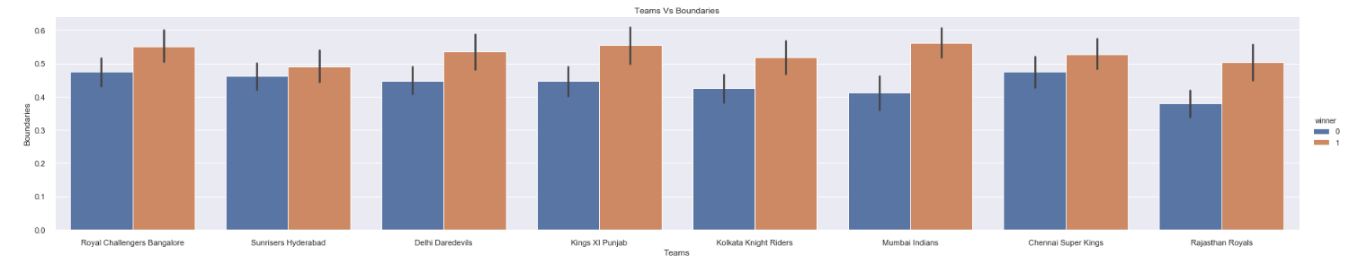
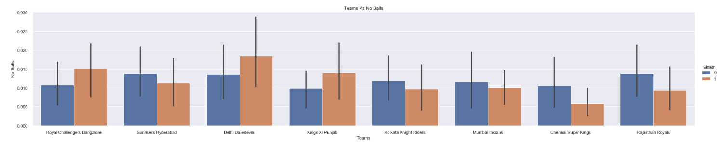
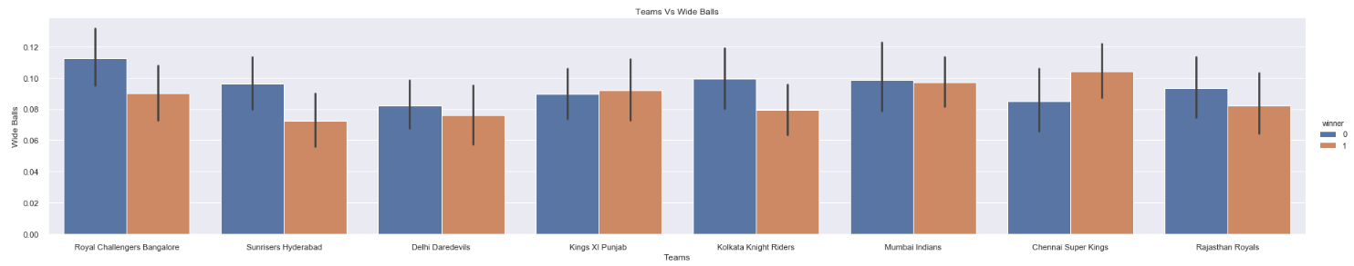
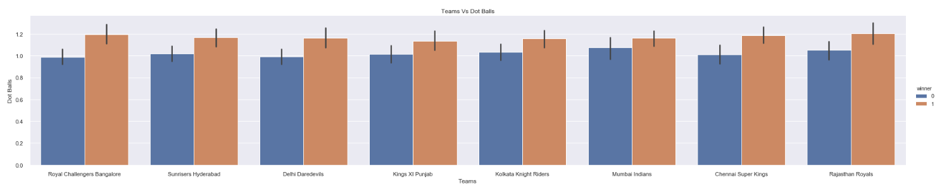
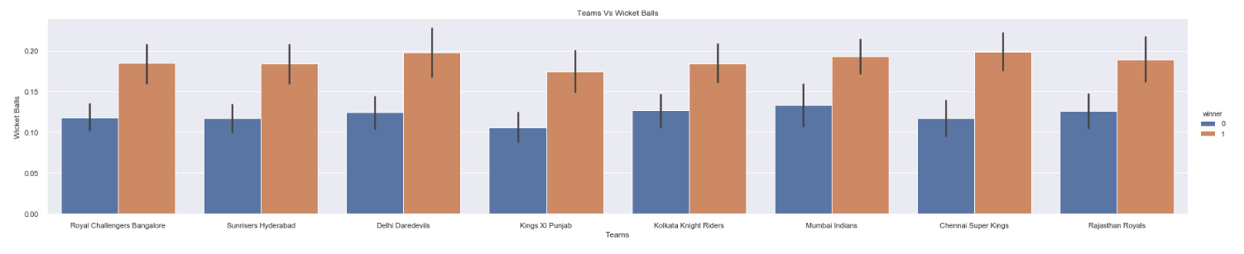
Team Statistics
Consistent trend of team hitting more boundaries won more matches.
No consistent pattern in wide/no ball statistics.
Consistent trend of team bowling more do/wicket balls won more matches.

Slide 6
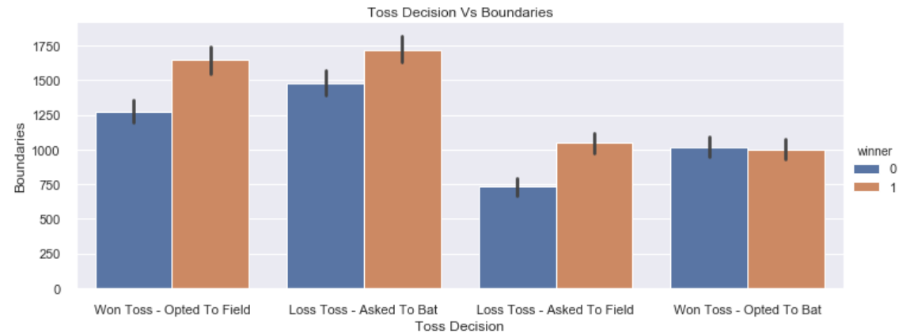
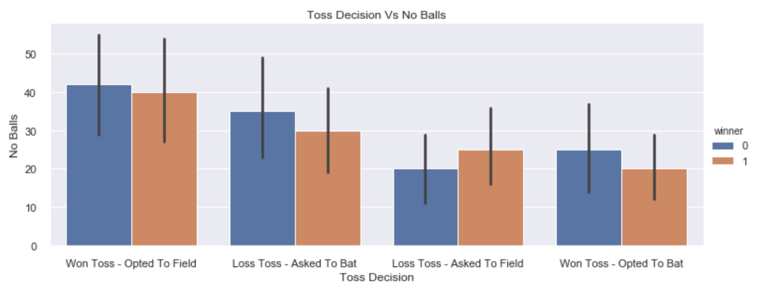
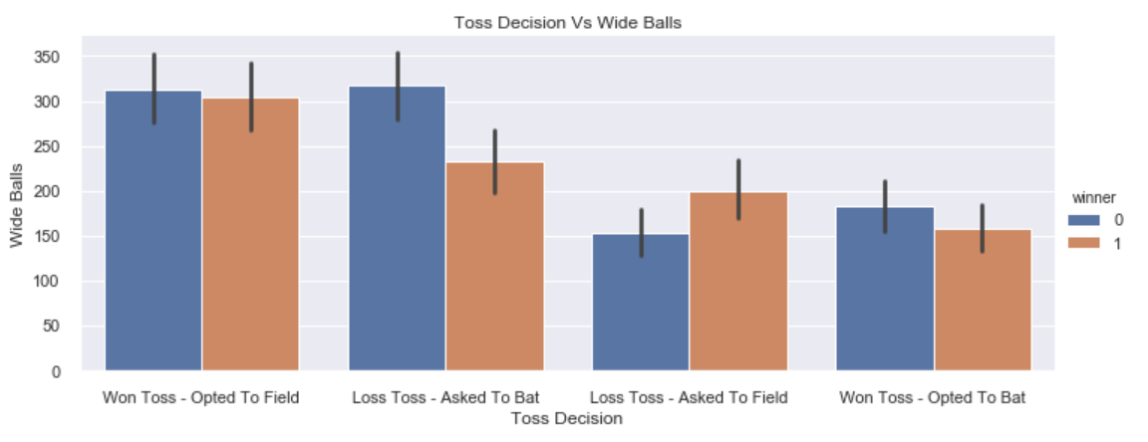
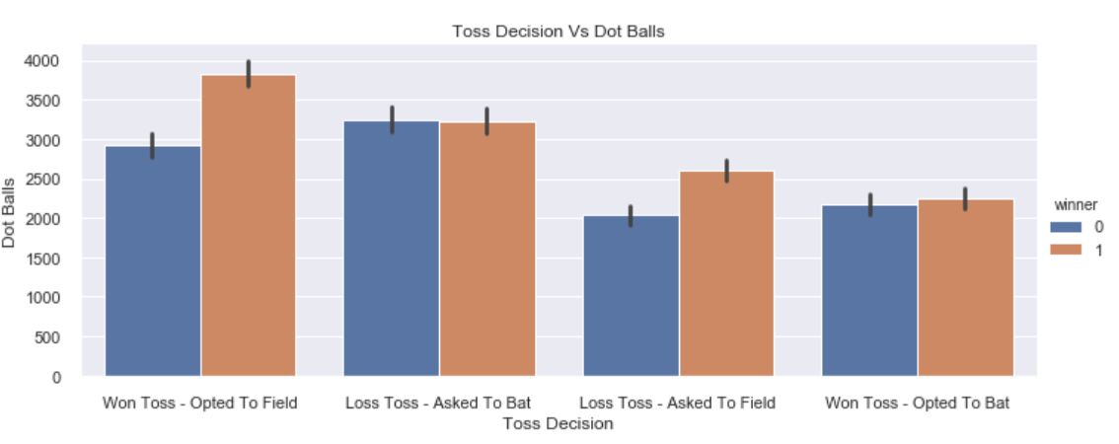
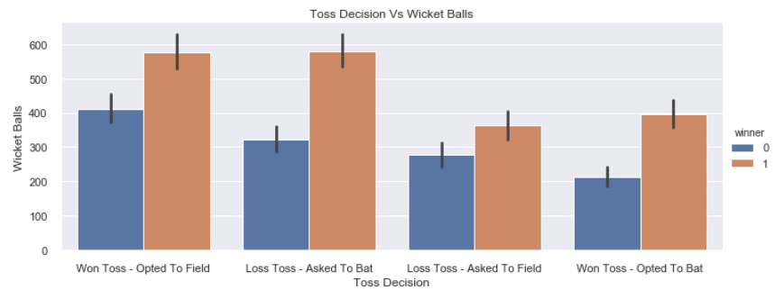
Wins/losses - Comparing key stats and bat first/bowl
Toss has no impact on boundary ball to win/loss stats.
Team winning toss bowled more no balls and lost more matches. Team losing toss bowled less no balls.
Wide balls - Mix trend, no specific pattern.
Toss has no impact on dot ball to win/loss stats.
Irrespective of toss decision, team hitting more boundaries, bowling more dot and wicket balls won more matches.

Slide 7
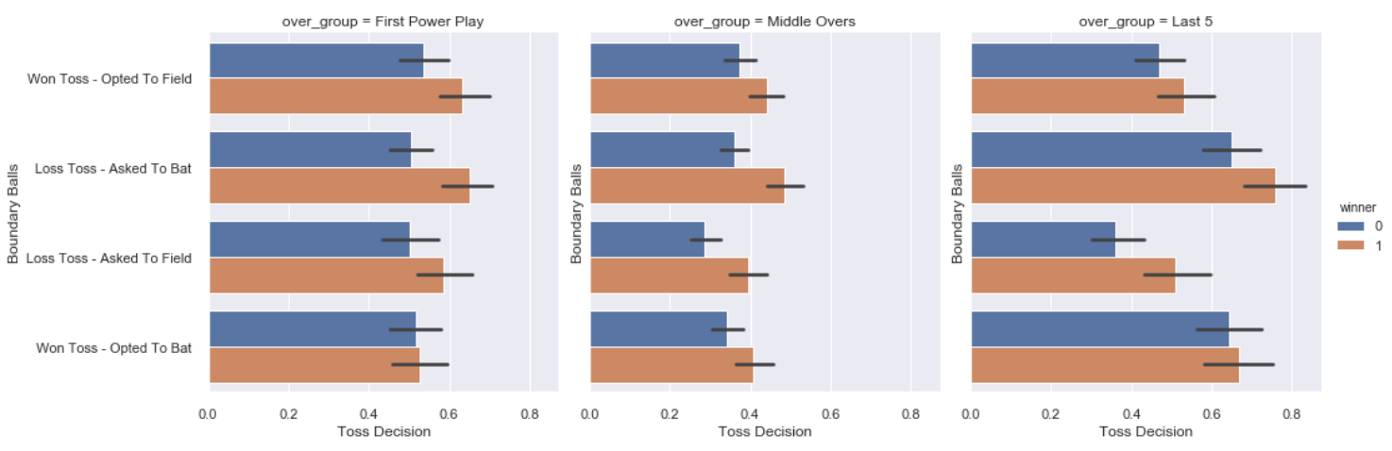
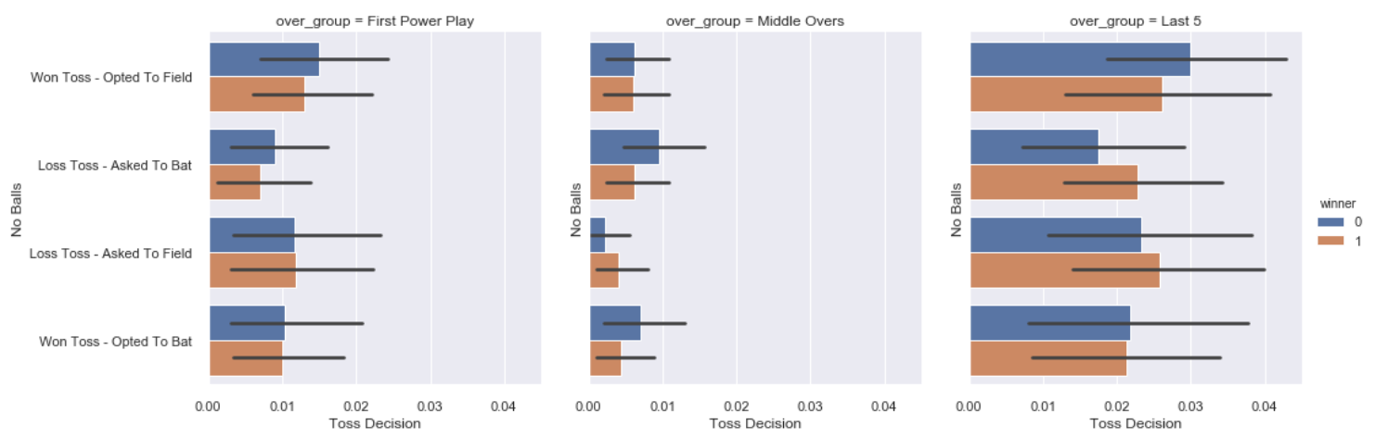
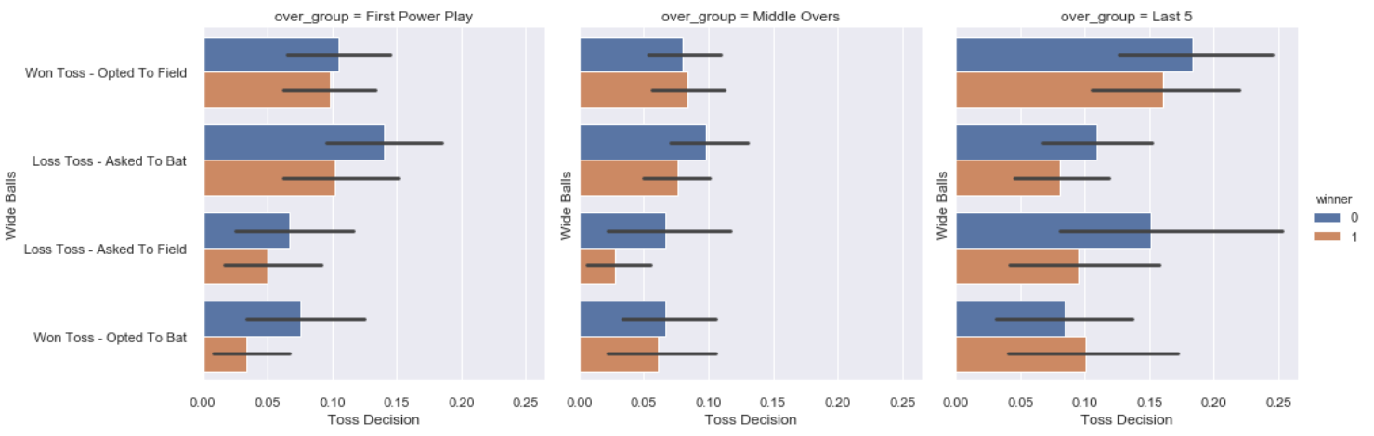
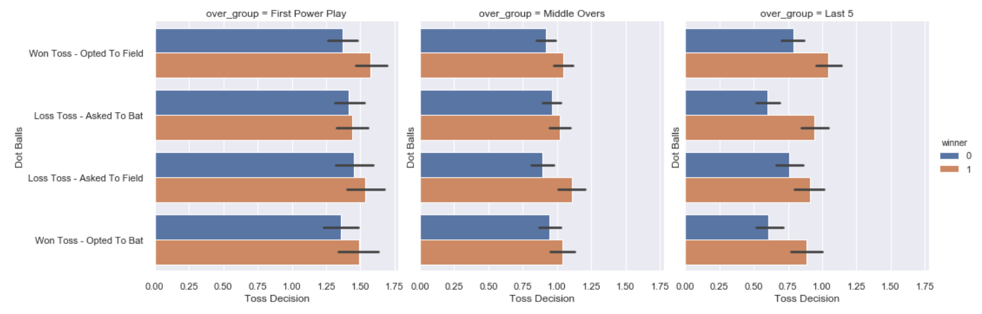
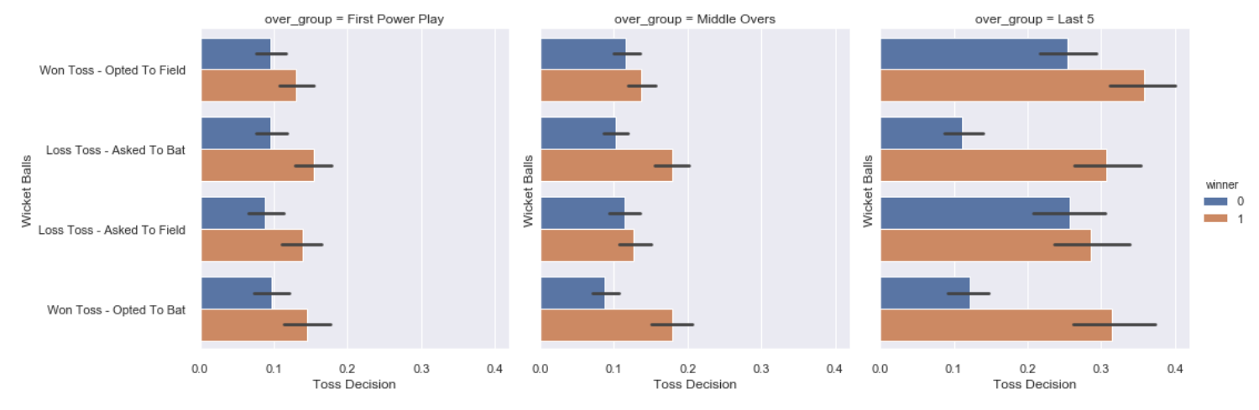
Segment over in bins and compare performance
Hitting more boundaries has helped teams to win more matches. No/Wide balls - Mix trend, no specific pattern.
Team bowling more dot balls won more matches. This is applicable consistently across over groups.
Team bowling more wicket balls won more matches. This is applicable consistently across over groups.

Slide 8
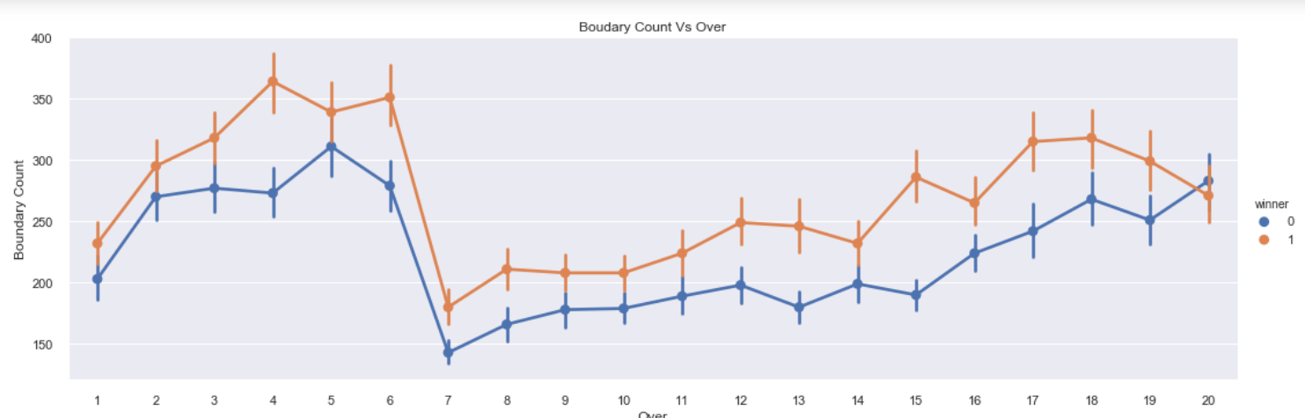
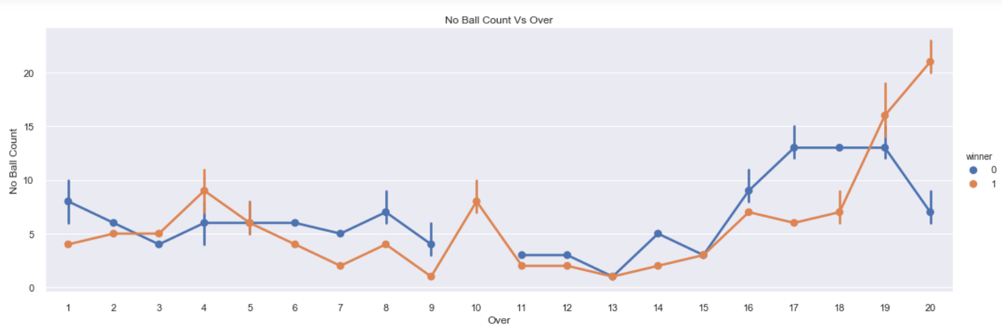
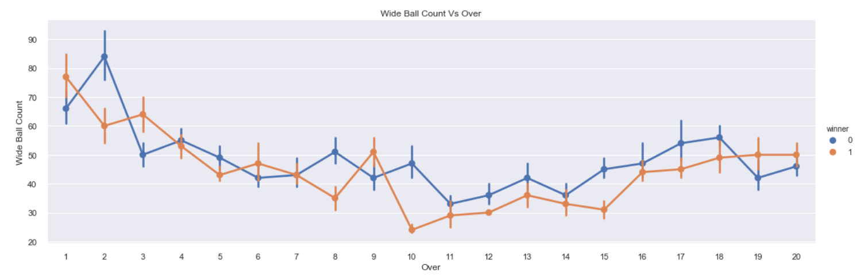
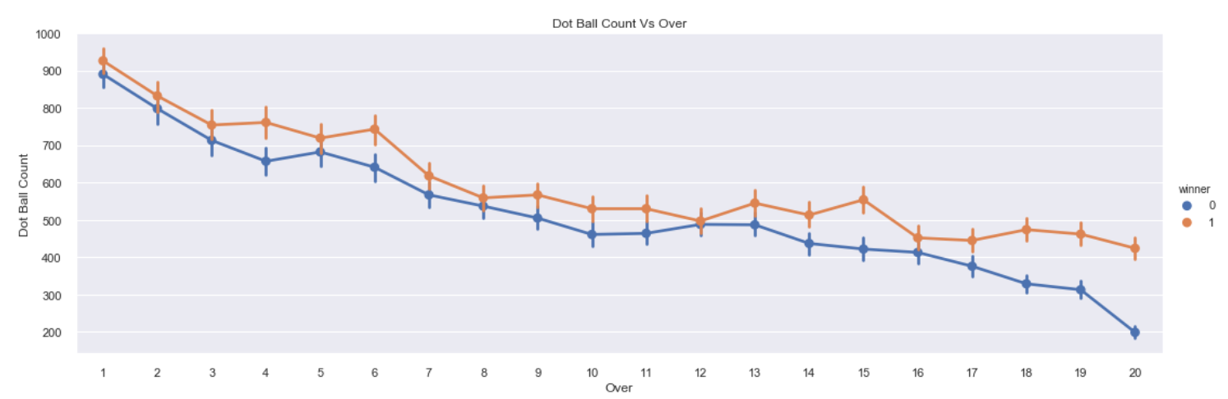
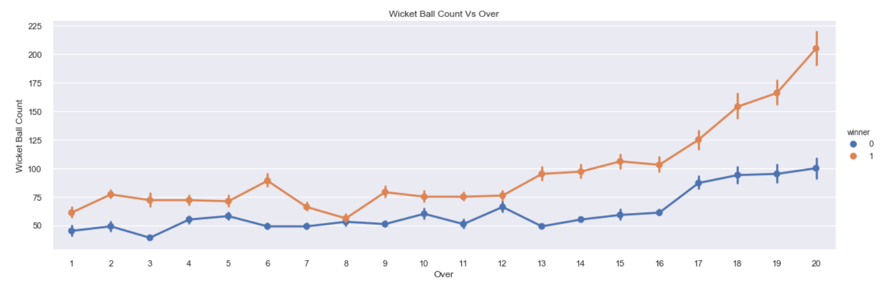
Segment over in bins and compare performance
Conclusion:
Above plots shows below Count of boundaries per Over Count of no balls per Over Count of wide balls per Over Count of dot balls per Over Count of wickets taken per Over, respectively.
Team scoring more boundaries, bowling more dot balls and taking more wickets ended up winning more matches.

Slide 9
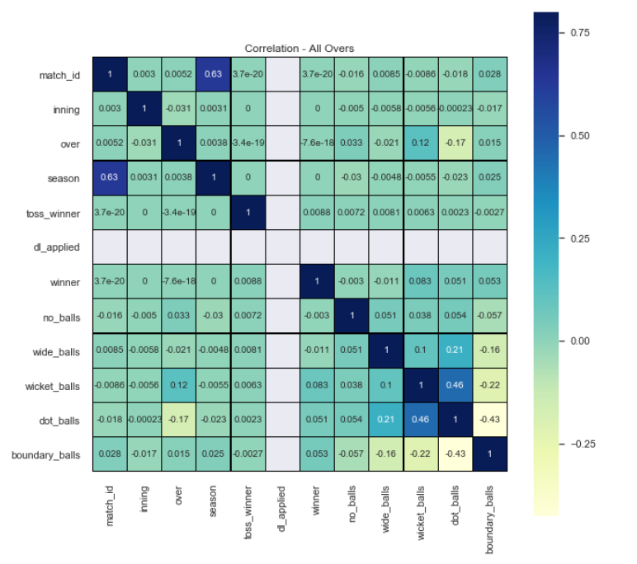
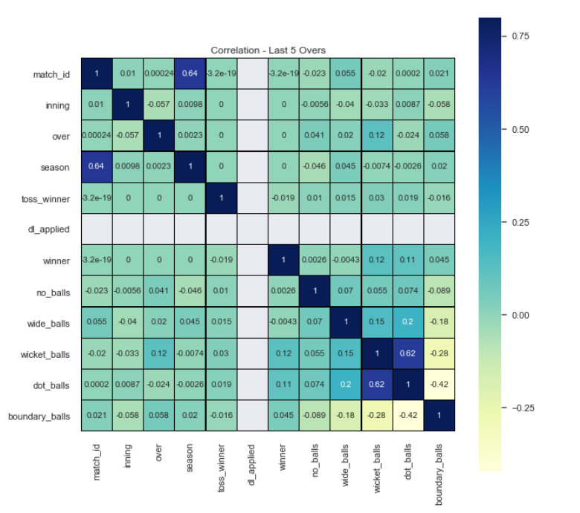
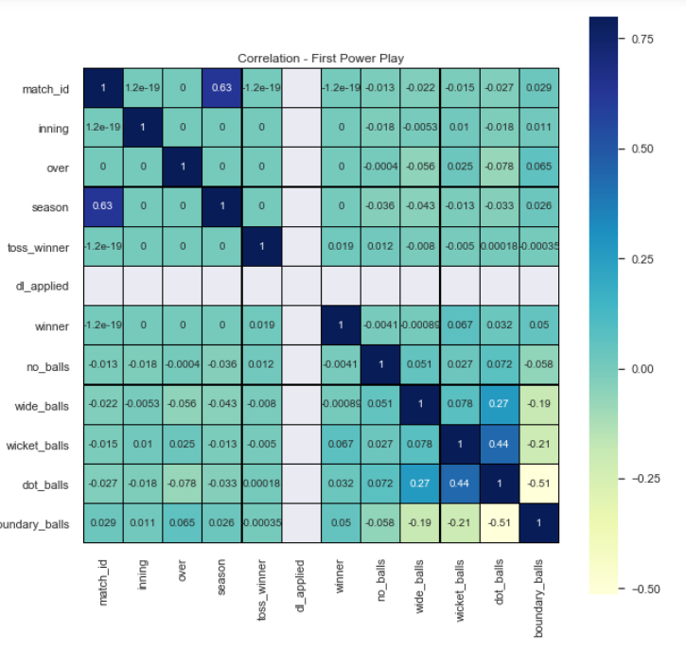
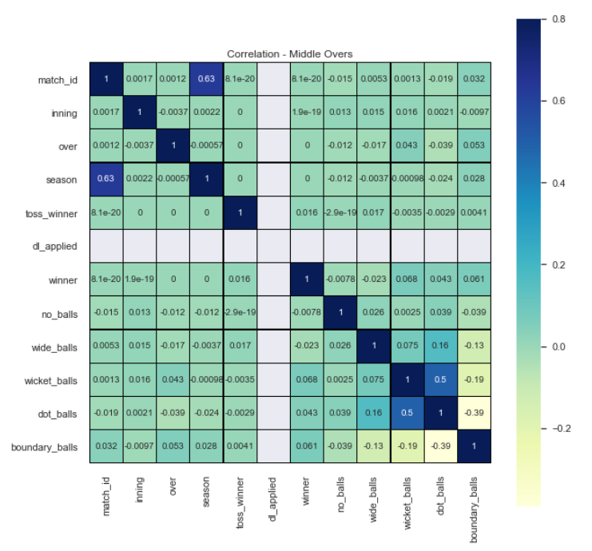
Segment over in bins and compare performance
Conclusion: Match and season has strong positive correlation. Wicket ball and over has positive correlation. This oblivious, lets ignore this.
Lets review Winner correlation :
Winner - Dot, Wicket and Boundary ball count correlation remain positive across over groups. Correlation was highest in last five overs. Dot balls - 0.13, Wicket balls - 0.12 , Boundary balls - 0.036 and Toss winner - 0.028.
Winner - No balls and wide balls correlation fluctuated from positive to negative across over group.

Slide 10
Conclusion
Good number of innings lasted till last 5 overs (16-20).
Team bowling more dot balls, wicket balls and scoring boundaries has better chance of winning matches.
There was mix trend between number of wide balls/no balls bowled by team and result (won/loss)

